Slide 1
QUANTUM AGE
ROMAN ASTRAKHANTSEV
Cyber security 171
HSE

Slide 2
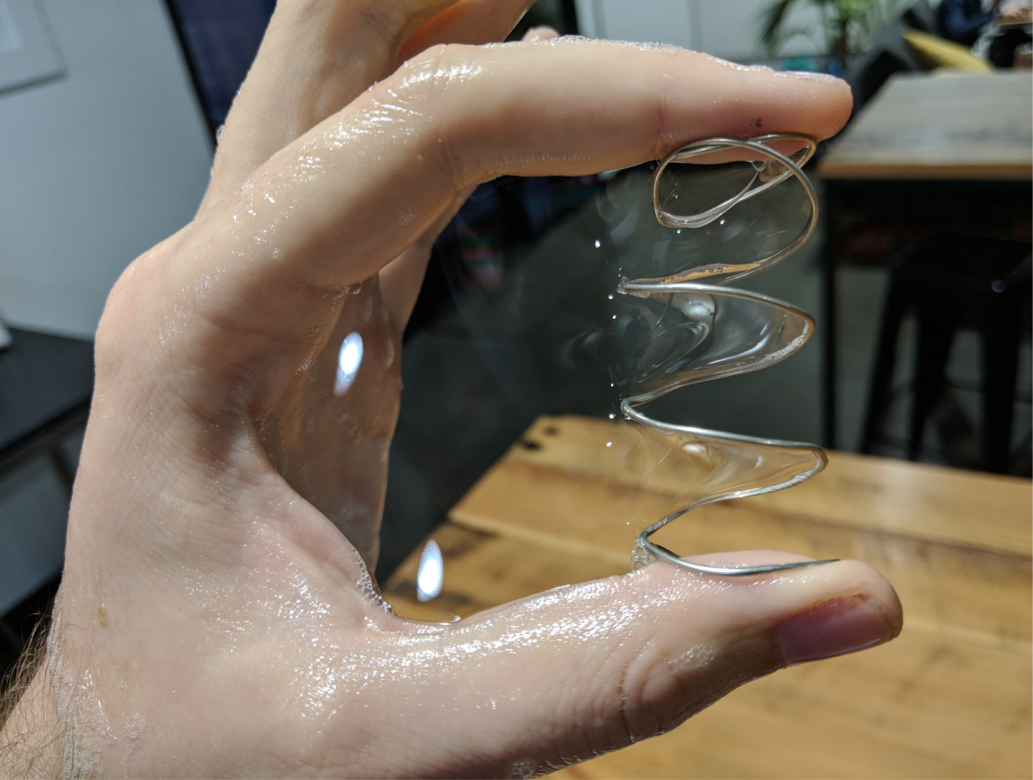
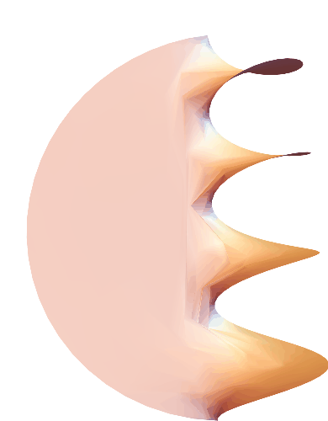
Idea Of Quantum computing
Answer by physics
Answer by math

Slide 3
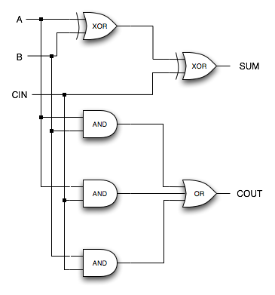
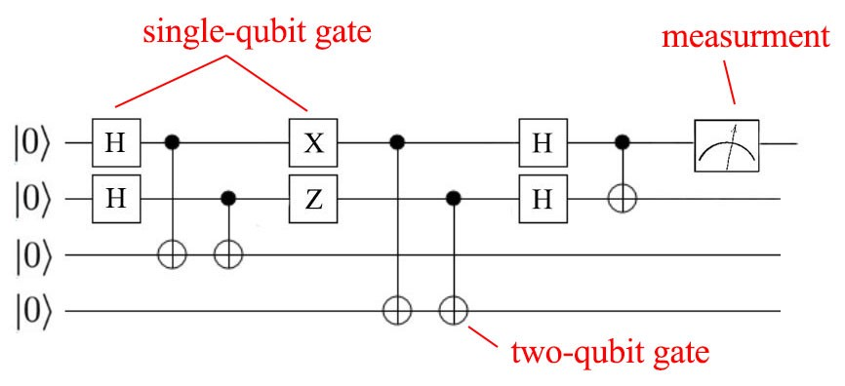
Computing types
Classical
Quantum

Slide 4
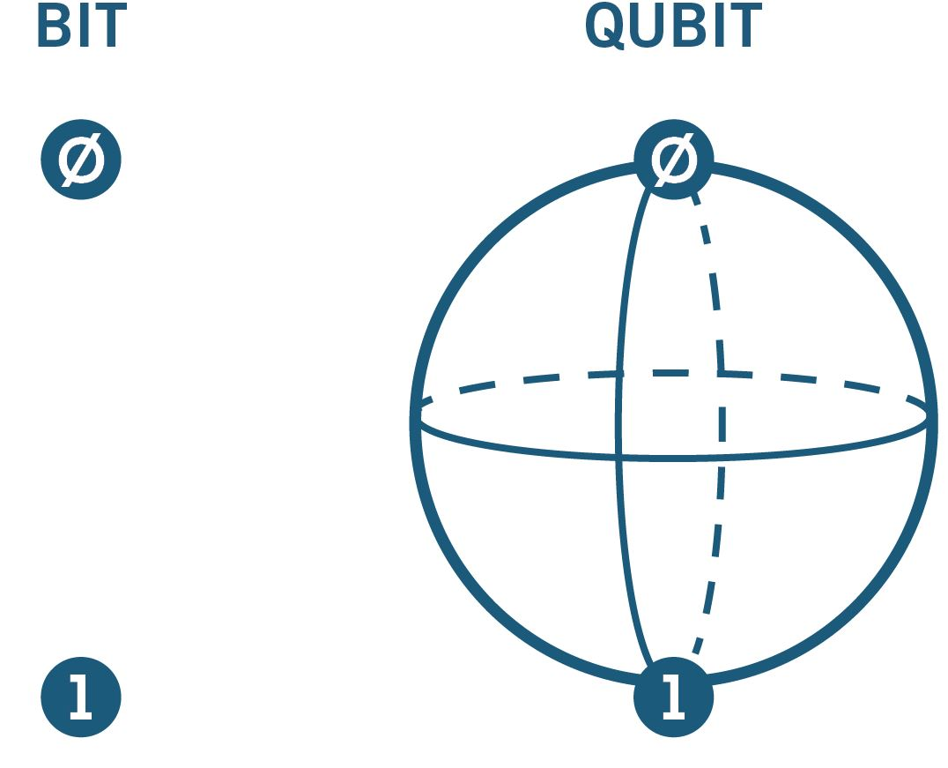
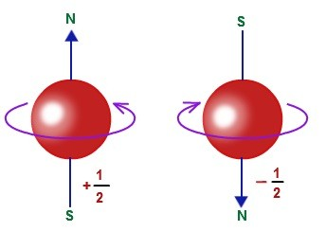
What Is a Qubit?
System with 2 states
System with 2 states

Slide 5
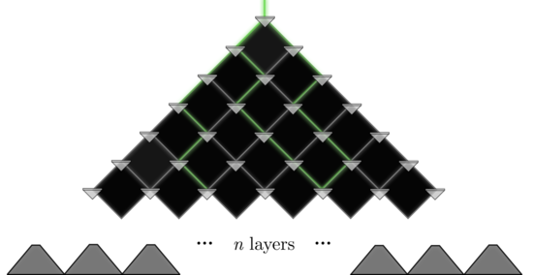
What are the benefits?
N qubits = 2^N computer bits

Slide 6
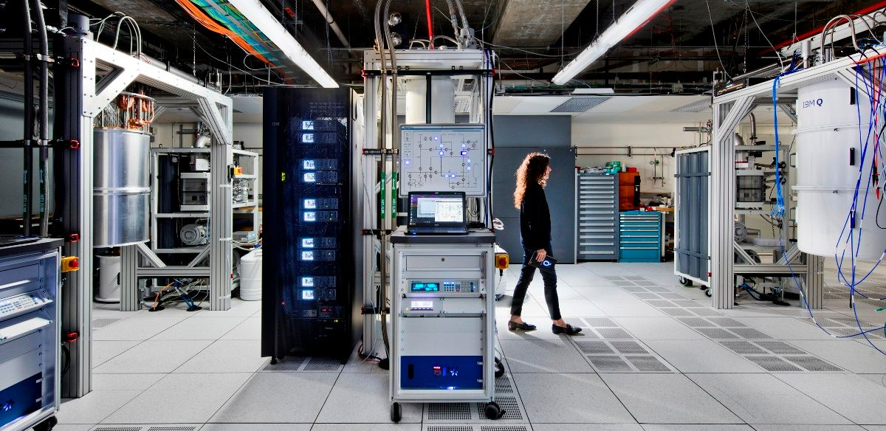
WHAT Do you see?

Slide 7
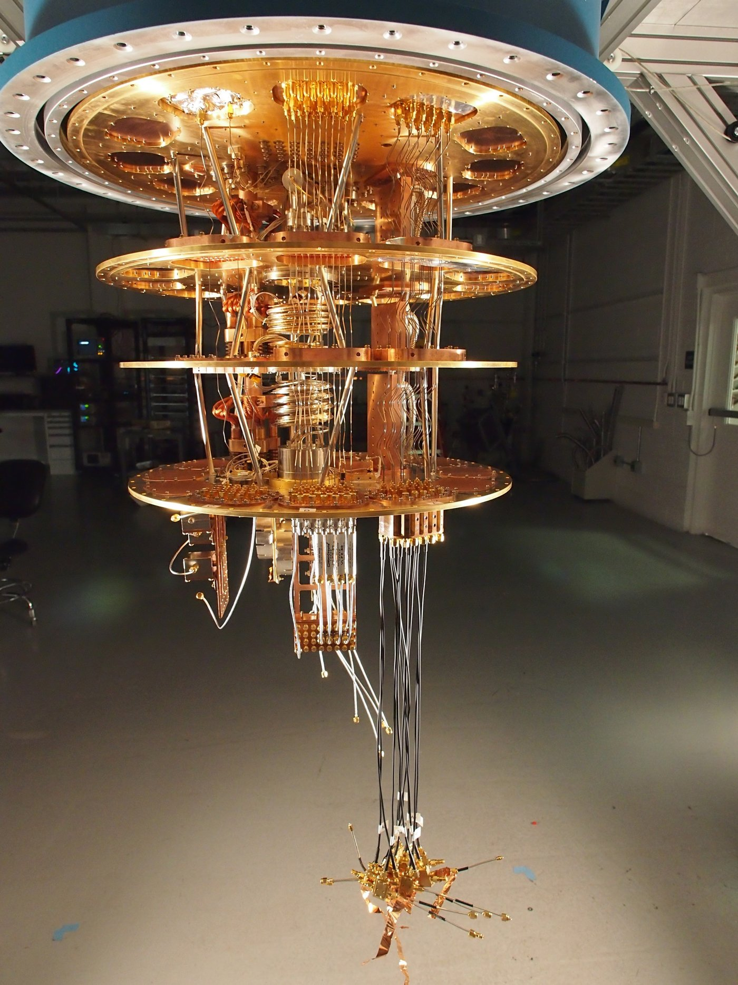
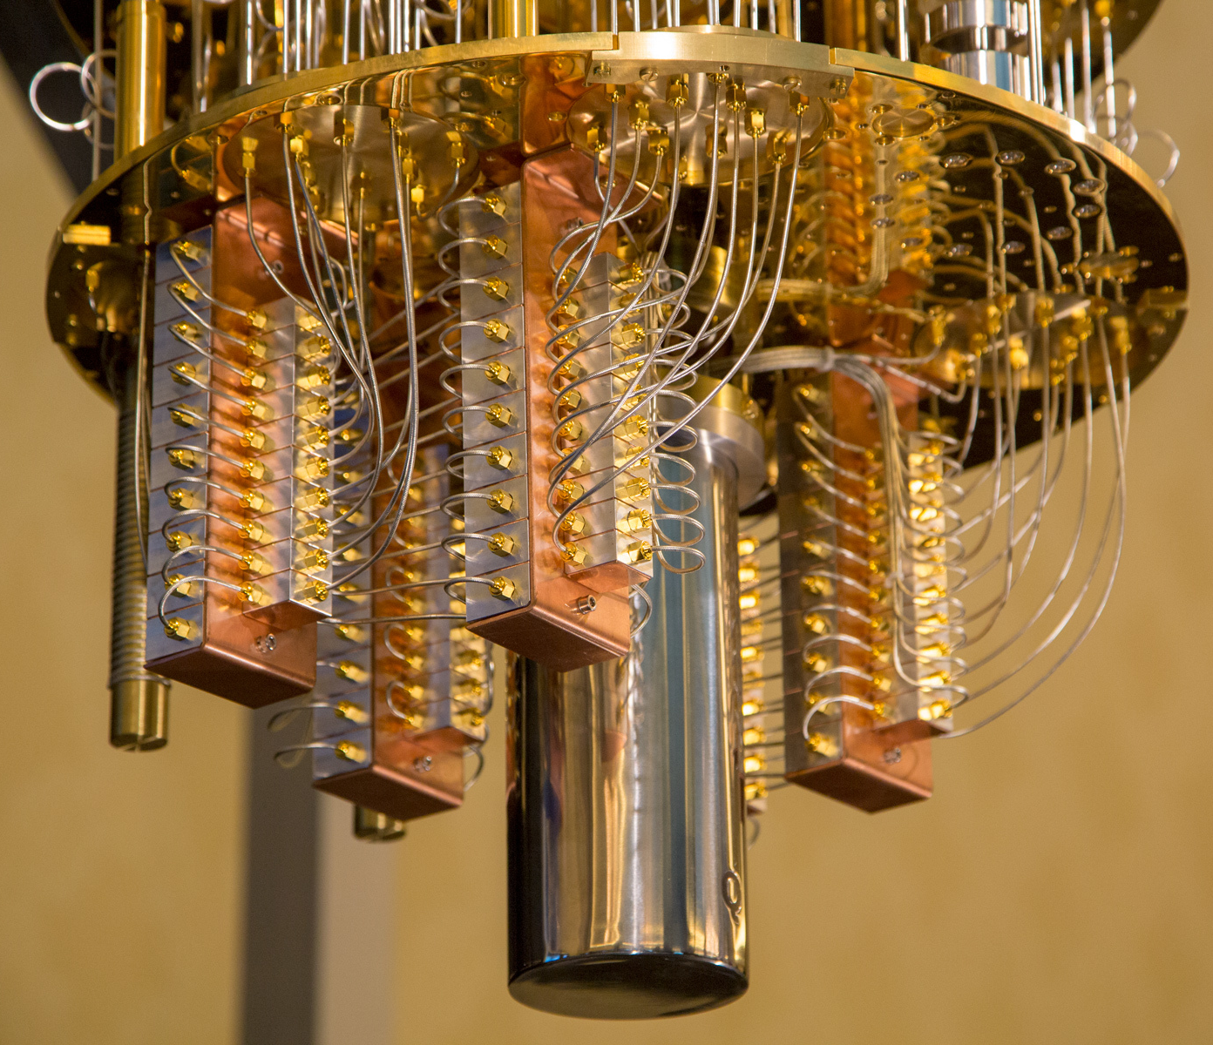
Google quantum computer

Slide 8
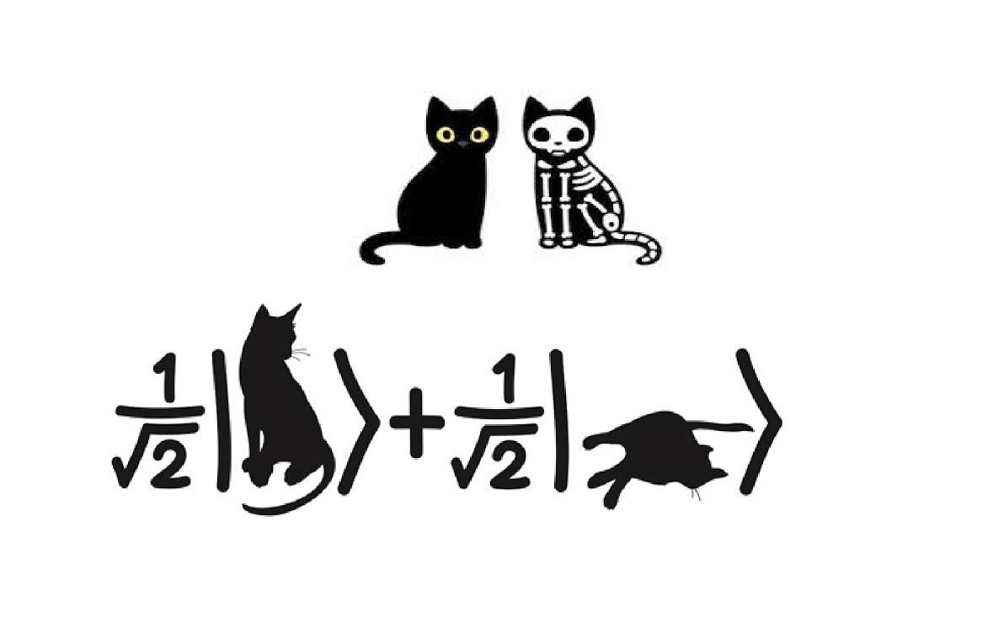
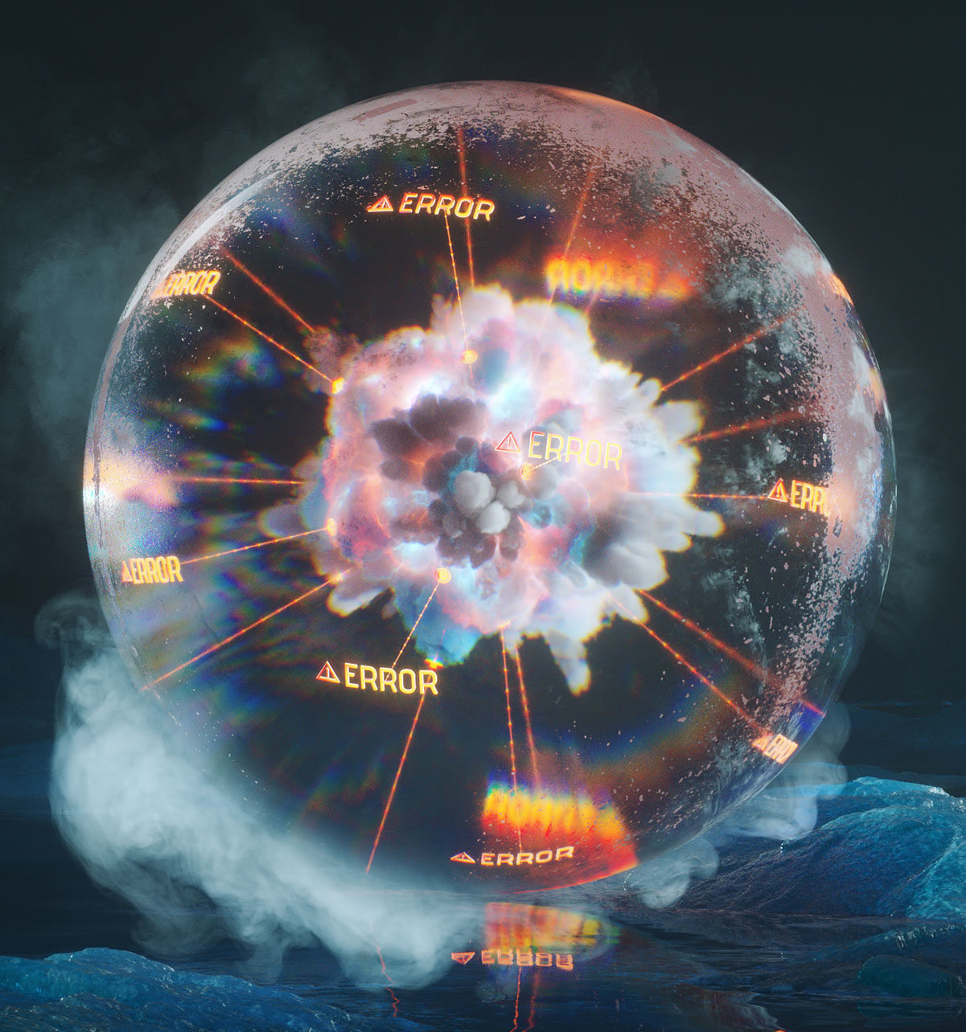
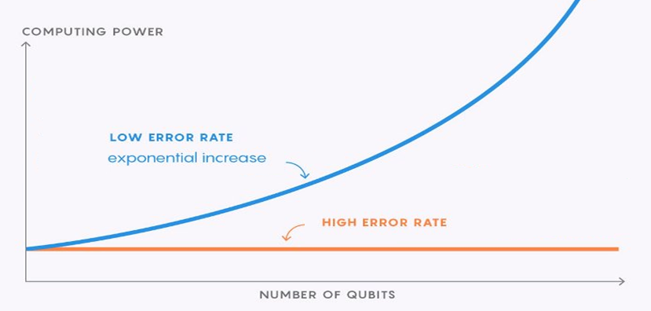
Problems: errors

Slide 9

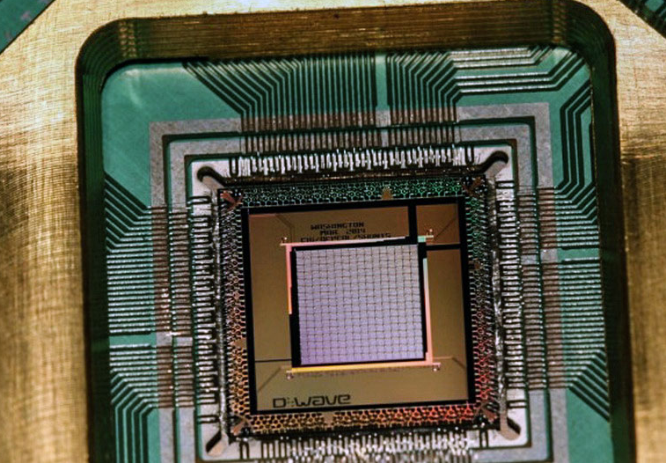
The conclusion
NICE CONSEPTION

Slide 10
Sources
https://www.technologyreview.com/s/602283/googles-quantum-dream-may-be-just-around-the-corner/
https://brilliant.org/
https://x.company/
http://se.math.spbu.ru/SE

Slide 11
Thank you for you attention!

